Slide 1


Starting a Functional Programming User Group in your Town
presented by Bryan Hunter Firefly Logic
Not NDA… Tweet away!
#mvpsummit
@bryan_hunter
@fireflylogic

Slide 2
?

Slide 3

http://nashfp.org

Slide 4
Supply and Demand
supply
demand

Slide 5
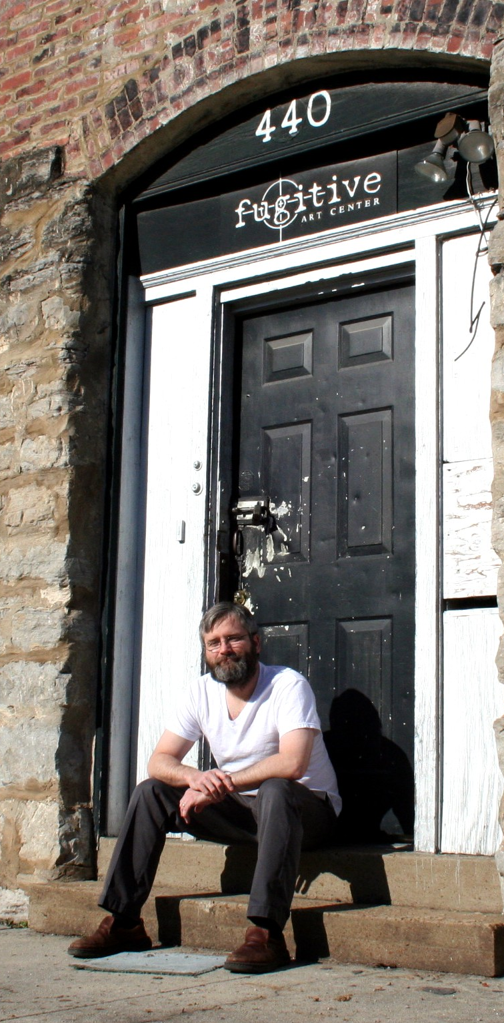





Oct 2008
Nov 2009
2010
NashDL
2010
2011
Jan 2012-Now

Slide 6
Active vs. Passive Learning
Show-and-Tell
Labs and Dojos
No slides
No one left behind
Constant chatter

Slide 7







Polyglot

Slide 8

Three Hours

Slide 9


Slide 10
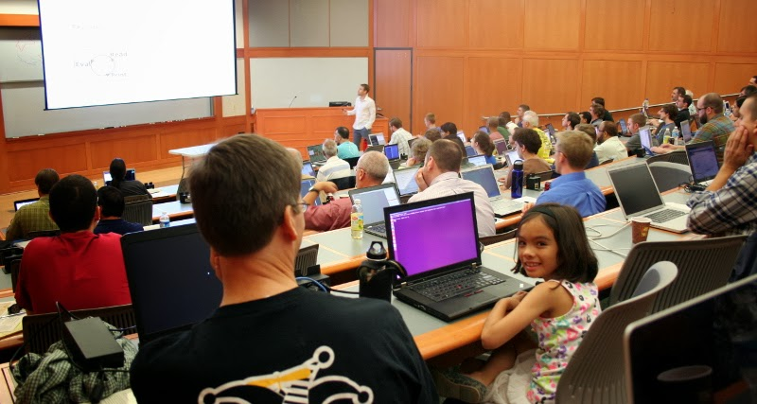
A Safe Place

Slide 11
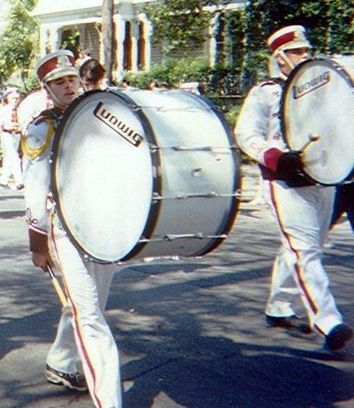

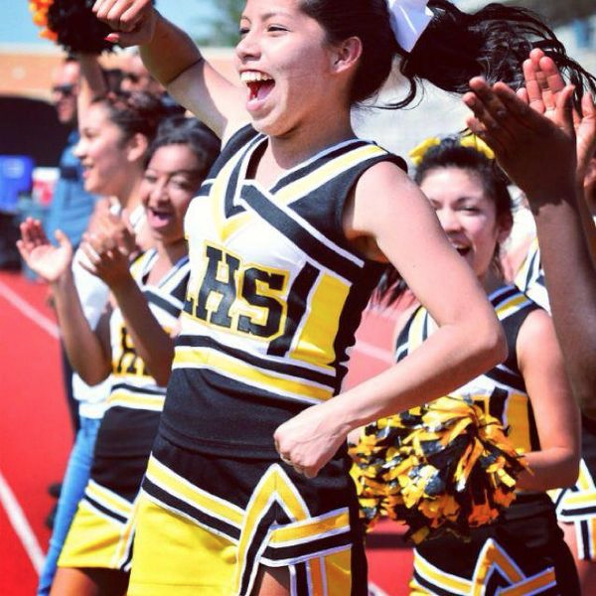
Cheering

Slide 12

Pilgrimage

Slide 13
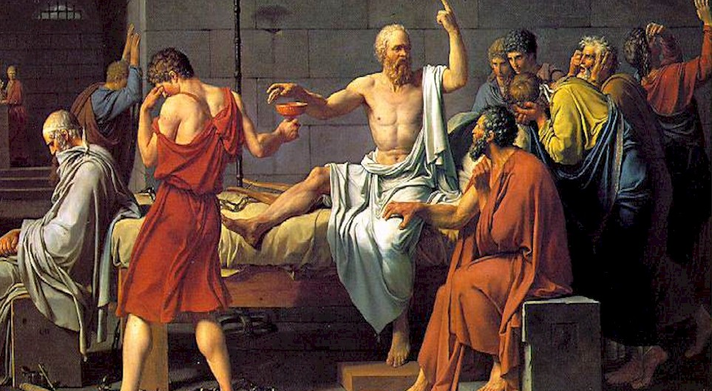
FP and Ethics

Slide 14
Thanks!
Bryan Hunter
Twitter: @bryan_hunter
Email: bryan.hunter@fireflylogic.com Skype: huntercb
Firefly Logic, Inc.
1000 Main Street #201 Nashville, TN 37206
http://fireflylogic.com
> keep in touch

